Slide 1



HAND GESTURE VOLUME CONTROL
Abdelrahman Tarek, Hatem Hussein, Rawan Yasser, Yasmine Moataz, Yousif Hamdi
01

Slide 2

The Challenge And The Fix
  Problem: Traditional inputs (mice, keyboards) are clunky and limit natural interaction.
→ Our Solution: Webcam-based system for real-time hand tracking and volume control.
  Why Cool? Touch-free, intuitive, usable, and accessible for everyone.
02

Slide 3


HCI Perspective
  Uses natural hand gestures for interaction
  Provides real-time visual feedback
  Minimizes effort—no physical contact needed
  Supports intuitive and direct interaction
  Follows HCI principles such as usability & simplicity
03

Slide 4
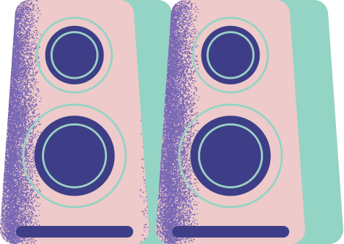
System Architecture
  Camera Input Module – captures real-time video
  Hand Processing Module – MediaPipe detects landmarks
  Visualization Module – overlays points on video
  Smooth, responsive real-time pipeline
04

Slide 5
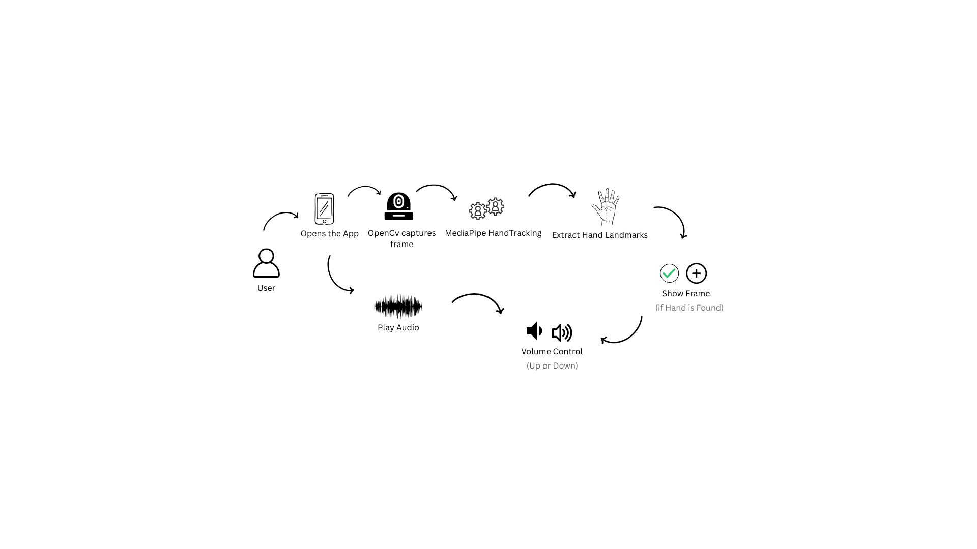

System overview Diagram
05

Slide 6

Our User Interface
  The screen has two main parts: Settings and Volume Control.
  In Settings, the user can turn on/off volume control, finger tracking, and sound feedback.
  There is a sensitivity slider to adjust how easy it is for the system to detect gestures.
  The Volume Control section shows the camera area where the user places their hand.
  It displays the distance detected between fingers and the current volume level.
  The UI is designed to be simple, clear, and easy to use.
06

Slide 7
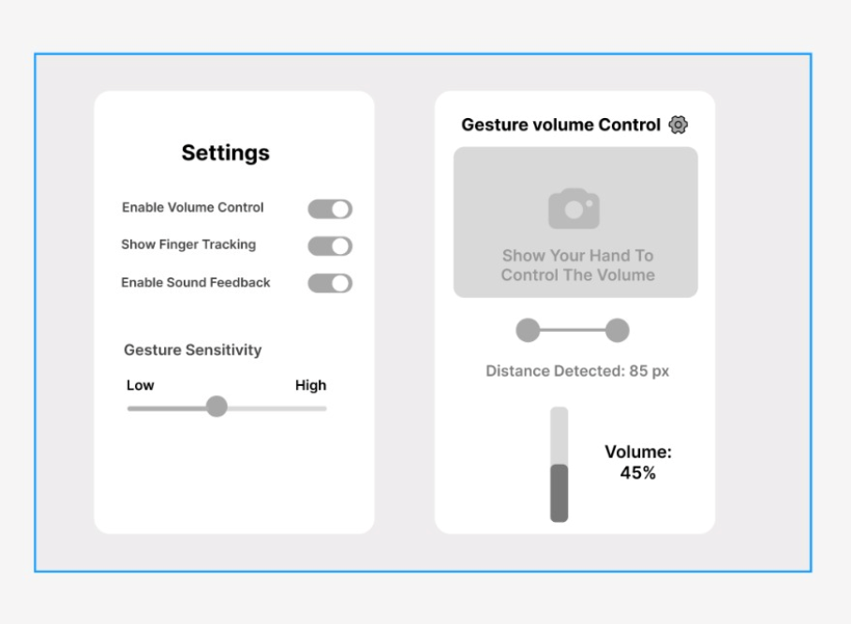
07

Slide 8

Tools & Technologies used
  Python – backend programming
  OpenCV – video capture & processing
  Webcam with cv2.VideoCapture
  MediaPipe Hand Tracking – 21 landmarks
  No database needed – real-time processing only
08

Slide 9
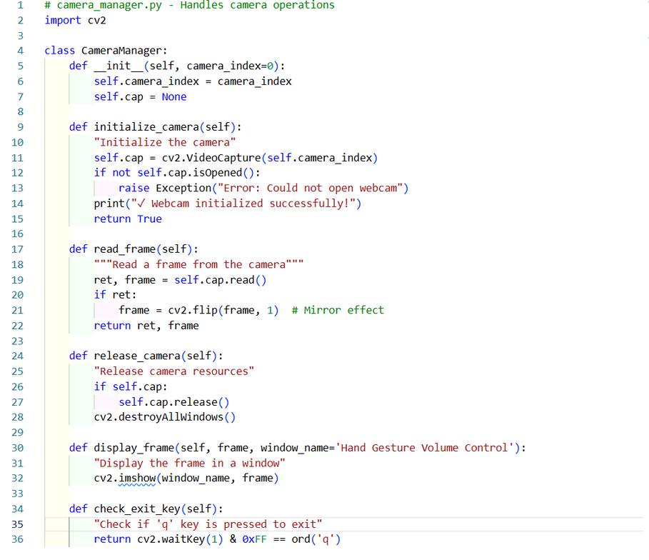
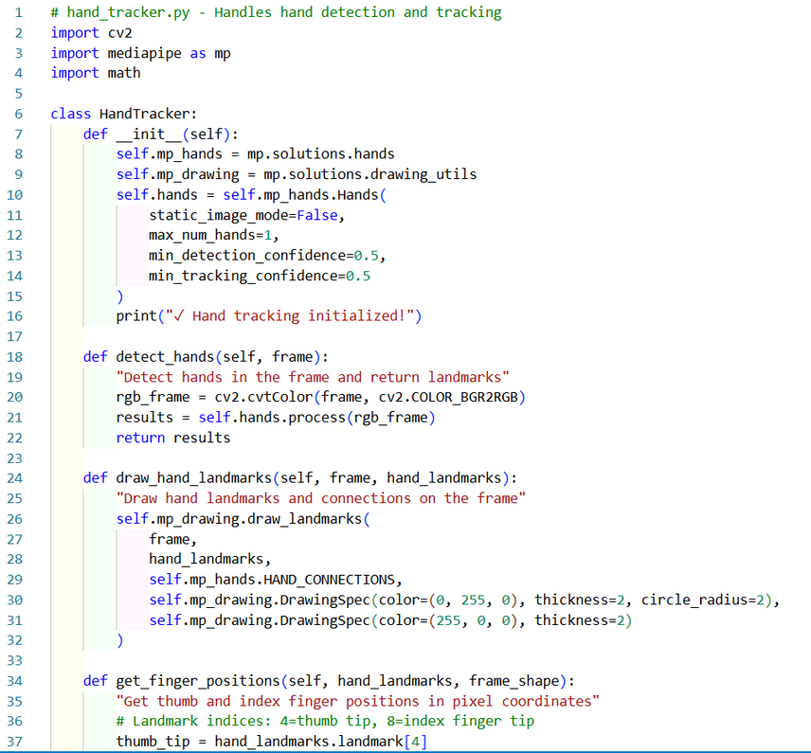
Concept Code
09

Slide 10
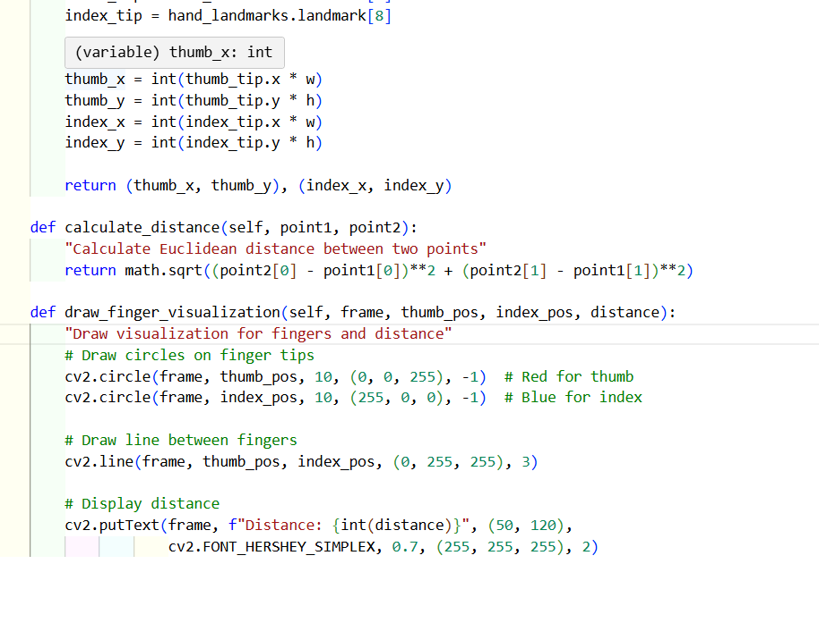
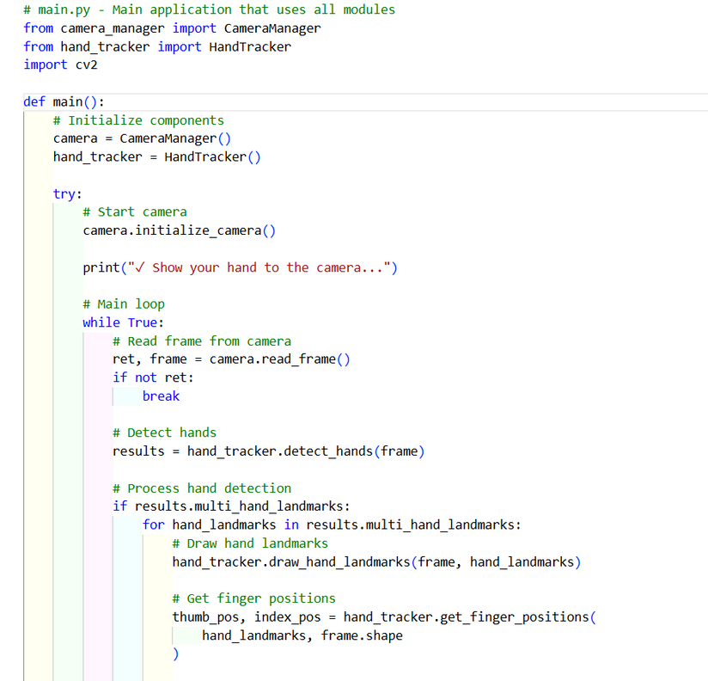
Concept Code
09

Slide 11
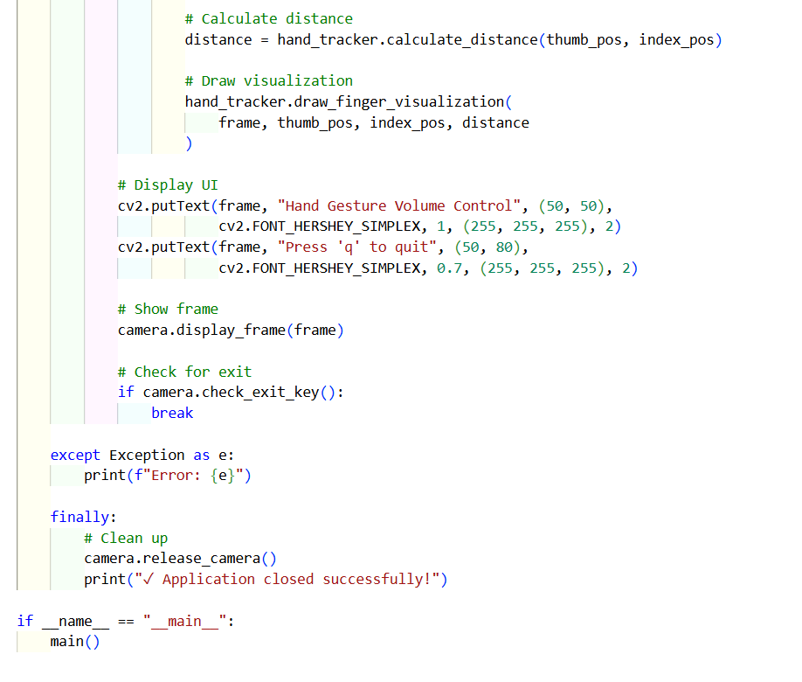
Concept Code
09

Slide 12
Gesture Volume Control
  Measures distance between thumb & index finger
  Maps gesture distance to volume range
  Finger pinch = volume down
  Finger spread = volume up
  Updated live with visual feedback
10

Slide 13
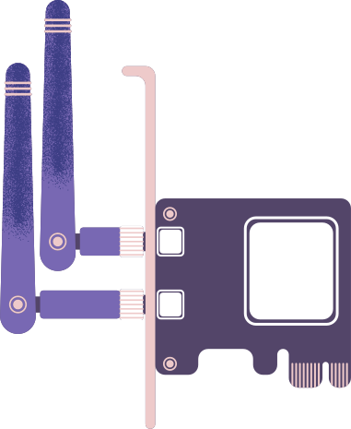
Conculsion
  Simple and intuitive gesture-based system
  Accurate hand tracking with MediaPipe
  No physical devices required
  Responsive and user-friendly design
  Strong base for future gesture features (mute, play, etc.)
11

Slide 14


Thank You
12

